Slide 1
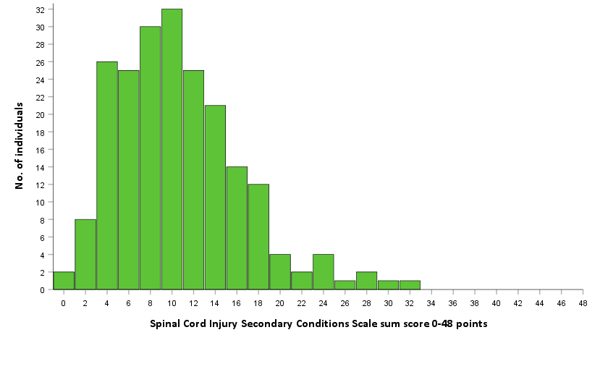
Secondary conditions in a sample of 224 persons with chronic SCI using the Spinal Cord Injury Secondary Conditions Scale
Vivien Jørgensen RPT, PhD¹ and Emelie Butler Forslund RPT PhD^{2,3}
¹Sunnaas Rehabilitation Hospital, ²Spinalis Clinic, Aleris Rehab Station, ³Karolinska Institutet
Conclusion
Pain, sexual dysfunction and bladder dysfunction were the most significantly experienced problems in a sample of 224 persons with chronic SCI.
The Spinal Cord injury Secondary Conditions Scale may help professionals to prioritize interventions and undertake appropriate medical measures according to the individual scores.
Urine
Sex
Pain
Introduction Secondary conditions are frequently reported after spinal cord injury (SCI) and may interfere negatively with the person’s health and quality of life. Some of these conditions are partially preventable or may require medical treatment.
The SCI Secondary Conditions Scale (SCI-SCS) by Kalpakjian et al. 2006¹, consists of 16 items (listed in table below) scored on an ordinal scale 0-3 where 0=not experienced/insignificant problem, 1=mild/infrequent problem, 2= moderate/occasional problem, 3= significant/chronic problem, all during the last 3 months. Max sum score is 48.
An aim of this study² was to describe secondary conditions in a sample of 224 persons with chronic SCI using the SCI-SCS.
Methods: Cross-sectional study at Sunnaas Rehabilitation Hospital and Spinalis Clinic at Aleris Rehab Station. 224 consecutive patients attending regular follow-up at least 1 year after traumatic SCI were included. Descriptive statistics were used.
Results Mean age was 49.6 (SD 14.9) years, median years post injury 15 (IQR 6-25), 68% were AIS A-C and 32% AIS D. 51% had cervical, 41% thoracic and 8% lumbar injuries.
All score levels were represented in 14 of 16 SCI-SCS items. Median sum score was 10 out of 48 (min-max 0-31). Chronic pain (neuropathic), sexual dysfunction, musculoskeletal pain and bladder dysfunction were the most frequently reported significant/chronic problems. None scored heterotopic bone ossification or diabetes mellitus as a significant/ chronic problem.
Secondary Condition Scale items | Significant/ chronic problem | Moderate/ occasional problem | Mild/ infrequent problem | Not experienced/ insignificant problem
Chronic pain | 25 | 20 | 17 | 38
Sexual dysfunction | 19 | 18 | 18 | 41
Joint and muscle pain | 17 | 23 | 23 | 36
Bladder dysfunction | 17 | 16 | 17 | 50
Bowel dysfunction | 14 | 17 | 23 | 46
Muscle spasms | 12 | 18 | 26 | 44
Circulatory problems | 9 | 13 | 22 | 56
Urinary tract infections | 9 | 9 | 13 | 69
Contractures | 6 | 12 | 13 | 70
Pressure sore(s) | 6 | 5 | 9 | 80
Injury caused by loss of sensation | 3 | 9 | 16 | 73
Respiratory problems | 3 | 5 | 9 | 84
Postural hypertension | 2 | 9 | 16 | 74
Autonomic dysreflexia | 1 | 8 | 9 | 83
Diabetes mellitus | 0 | 3 | 2 | 95
Heterotopic bone ossification | 0 | 1 | 1 | 97
Distribution of the SCI-SCS sum score for the 210 patients with complete scores. The scale consists of 16 items scored from 0−3.
Proportions (%) of scorings on each single items of SCI -SCS and median sum score for the total sample (n=224) ordered according to magnitude of problem.
References
¹Kalpakjian CZ, Scelza WM, Forchheimer MB, Toussaint LL. Preliminary reliability and validity of a Spinal Cord Injury Secondary Conditions Scale. J Spinal Cord Med. 2007;30:131–9
²Jørgensen V, von Rosen P, Butler Forslund E. Considerations on the psychometric properties and validity of the Spinal Cord Injury Secondary Conditions Scale. Spinal Cord. 2021 Aug;59(8):894-901
Emelie Butler Forslund
emelie.forslund@aleris.se
Vivien Jørgensen
vivien.jorgensen@sunnaas.no

